Slide 1
Amalgamating Source Code Authors, Maintainers, and
Change Proneness to Triage Change Requests (2014)
Md Kamal Hossen, Denys Poshyvanyk
Presented By: Kevin Nguyen

Slide 2
Background Information
Change Request: A document containing a call for an adjustment of a system
Change requests/ bug fixes are very common in open source software, so assigning the right developers to handle each issue quickly is pivotal
There are existing methods to automatically recommend developers familiar with a change request’s issue based around examining source code, but this paper looks to use commit messages from a project’s software repository to improve upon said methods

Slide 3
The Paper’s Approach
iMacPro (LSI, Maintainers, Authors, and Change PROneness of source code)
1. Use Latent Semantic Indexing to locate relevant source code by using an unresolved change request description as the query
2. The top results from LSI are then ranked based on “change proneness”, which is based on a source code’s change history.
3. The developers of the newly ranked list are then examined and ranked to produce the final list of recommended developers for the queried change request

Slide 4
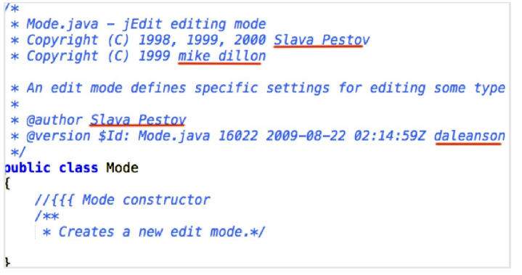
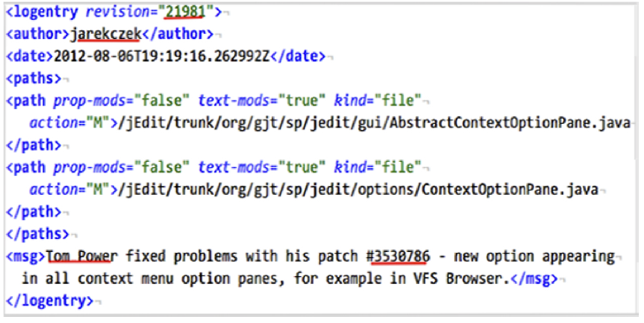
Key Terms
Author: The original developers and contributors of the source code; their names are usually found in the source code’s header comments
Maintainer: Developers who perform changes on source code based on change requests and bug fixes; found in Subversion (SVN) commit logs
Committer: Submits a change/ commit but isn’t responsible for the change itself

Slide 5

Key Terms (cont’d.)
Issue Fixing Commit (IFC): Commits explicitly documenting maintenance activities; determined by text processing commit message
Issue Change Proneness (ICP): Measure of a source code entity’s change affinity based on IFC’s; if a file has a history of 11 commits with 2 of them being IFC’s, then the file has an ICP of 2

Slide 6
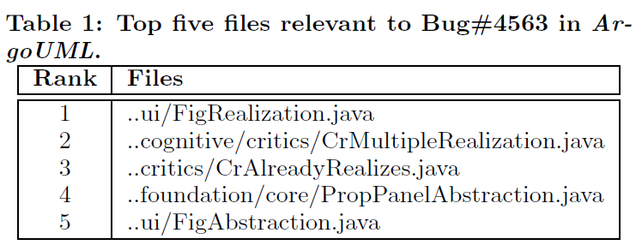
Latent Semantic Indexing
iMacPro uses LSI in order to query and indexed corpus based on a specified change request and obtain an initial ranked list of relevant documents

Slide 7
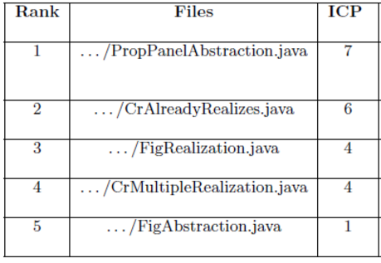
2. Ranking Source Files via Change Proneness
Why: The higher the change proneness of a source code file, the more likely it is that the file will request more changes
Calculate change proneness based on Issue Fixing Commits (max 20), with the most recent IFC’s taking priority

Slide 8
3. Extract Authors/ Maintainers from Source Code
Source code files are converted into srcML, a lightweight XML format to make extracting comments (i.e. author names in header comments) easier
Authors of relevant documents are ranked by order in which they appear (top-down left-right order)
Takes into account the same author may use different names (i.e. MichielvanderWulp, mvw@tigris.org, mvw)
Maintainers are extracted and ranked similarly but through the commit messages of relevant files
Most recent commit change made by a maintainer takes priority
Merge authors and maintainers Round Robin style

Slide 9
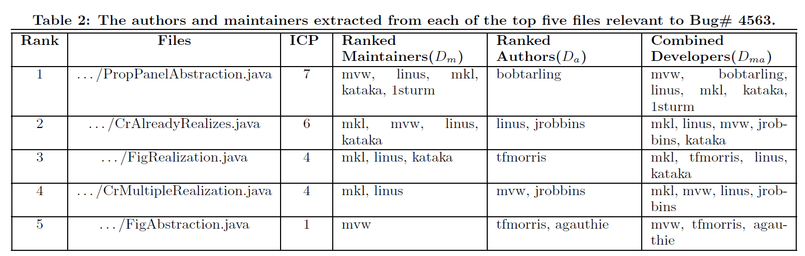
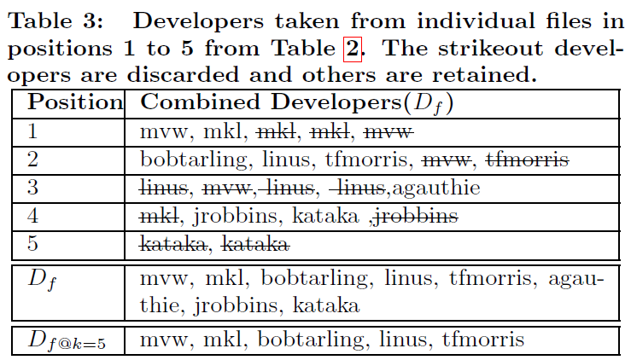

Slide 10
Empirical Study
This paper compares the effectiveness of iMacPro by comparing it to existing approaches to automate developer recommendations for change requests
iA: uses LSI to find relevant source code and extracts frequent authors for recommended developers, but doesn’t use change proneness or maintainers
iAcPro: uses change proneness like the iMacPro, but does not make use of maintainers

Slide 11
Research Questions
RQ1: What is the accuracy of iMacPro when assessed on open-source systems?
RQ2: How does the accuracy of iMacPro compare to iA, i.e., a previous approach based on the source code authorship alone?
RQ3: How does the accuracy of iMacPro compare to iAcPro, i.e., when the maintainer information is not utilized in iMacPro, giving us iAcPro?
Core Question: Is it worth it to consider maintainers when recommending developers for change requests?

Slide 12
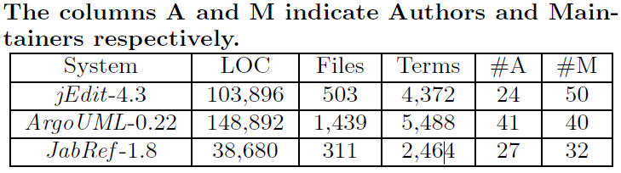
Subject Software Systems
For each system tested, the paper uses a manually created benchmark of change requests and a gold set of developers that actually addressed said change requests

Slide 13
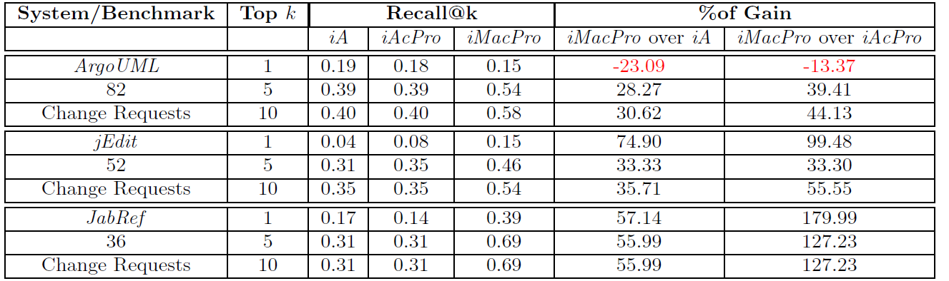
Metrics, Results, and Conclusions
Accuracy based on how many recommended developers of change requests were also the actual developers that addressed the issue
Measured using One Way ANOVA; Non-parametric

Slide 14
Questions
In your opinion, was ranking the LSI-relevant documents purely based on change proneness an effective technique? Should textual similarity have greater weight when ranking documents here?
How would you choose to rank the combined list of authors and maintainers of a source code file when trying to recommend a developer?
Should committers be included in the list of authors and maintainers?

